Slide 1

Cybercrime
CYBER CRIME

Slide 2
HISTORY
The first recorded cyber crime took place in the year 1820.
The first spam email took place in 1976 when it was sent over the ARPANT.
The first virus was installed on an Apple computer in 1982.

Slide 3
What is Cyber Crime?
1.Cybercrime refers to criminal activities carried out through digital means or the internet.
2.It encompasses a broad range of illegal activities that target individuals, organizations, or even governments with the intent of causing harm, stealing sensitive information, financial gains, or disrupting normal operations.

Slide 4
Two Main Categories of Cybercrimes
Most cybercrime falls under two main categories:
The computer as a target: using a computer to attacks other computer
E.g. Hacking, virus attacks
The computer as a weapon: Using a computer to commit real world crime
E.g. credit card fraud

Slide 5
Cyber Crime Attacks
Phishing: Cybercriminals send deceptive emails or messages to trick individuals into revealing sensitive information, such as login credentials or financial details.
Ransomware : malware designed to deny a user or organization access to files on their computer.
Malware: Malicious software can take many forms, including viruses, Trojans, and spyware, which infiltrate systems to steal information or cause damage.
4.DDoS Attacks: Distributed Denial of Service attacks overwhelm a website or network with a flood of traffic, making it inaccessible to legitimate users.
5. Supply Chain : A supply chain is a system of activities involved in handling, distributing, manufacturing, and processing goods in order to move resources from a vendor into the hands of the final consumer.

Slide 6
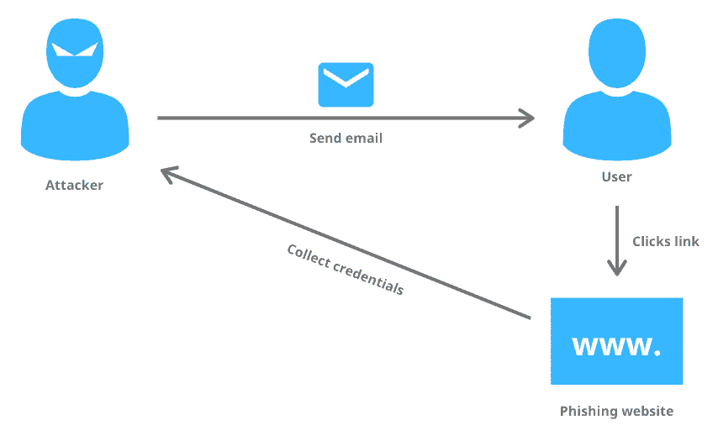
Phishing

Slide 7
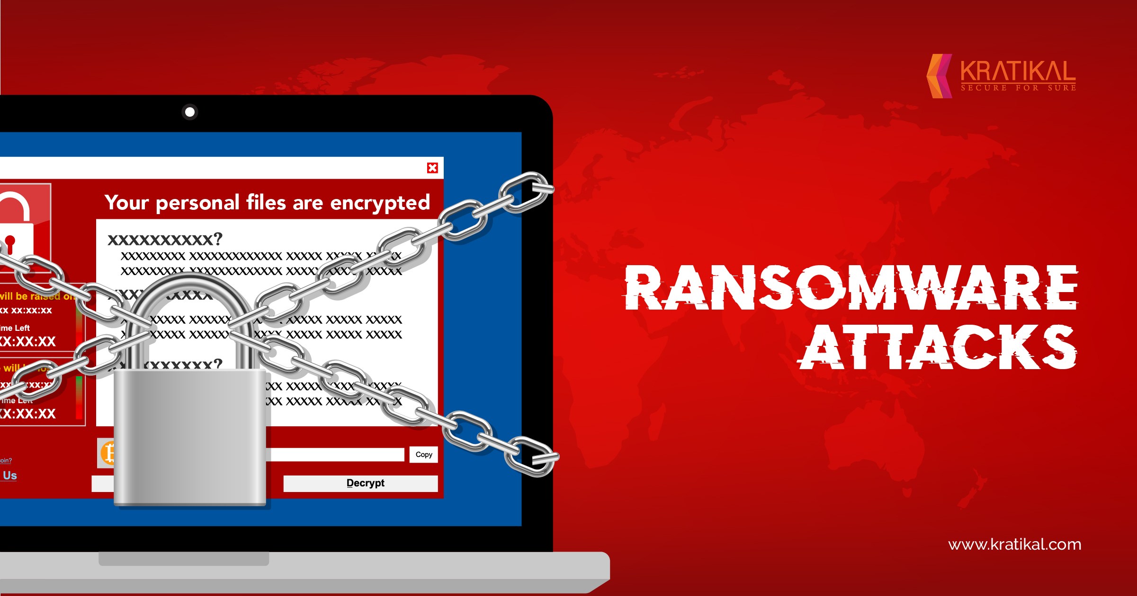
Ransom ware

Slide 8
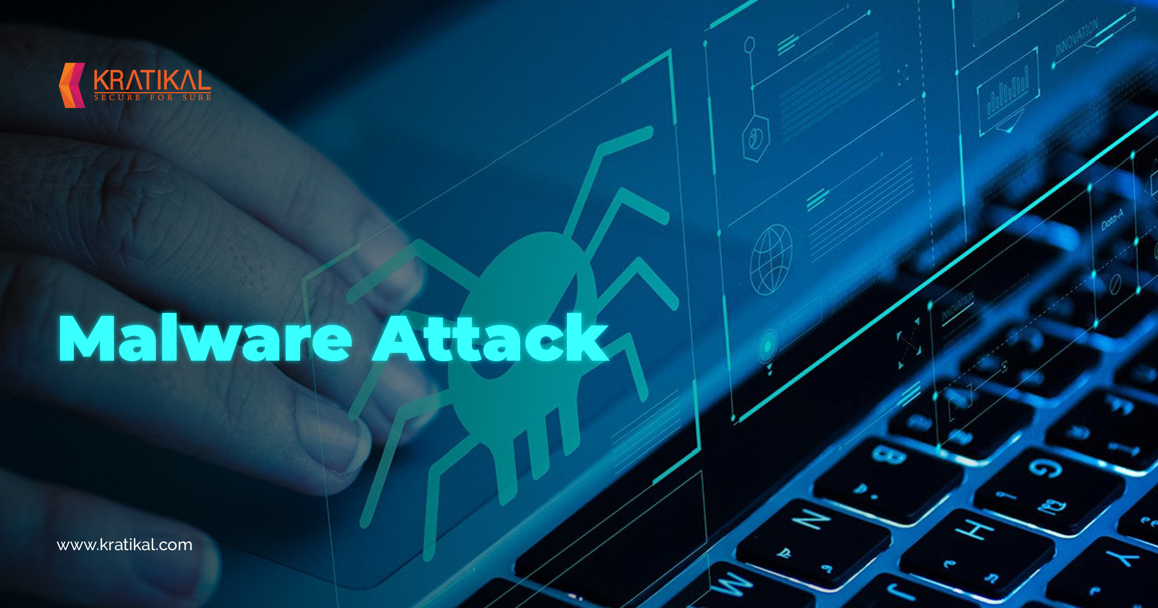
Malware

Slide 9
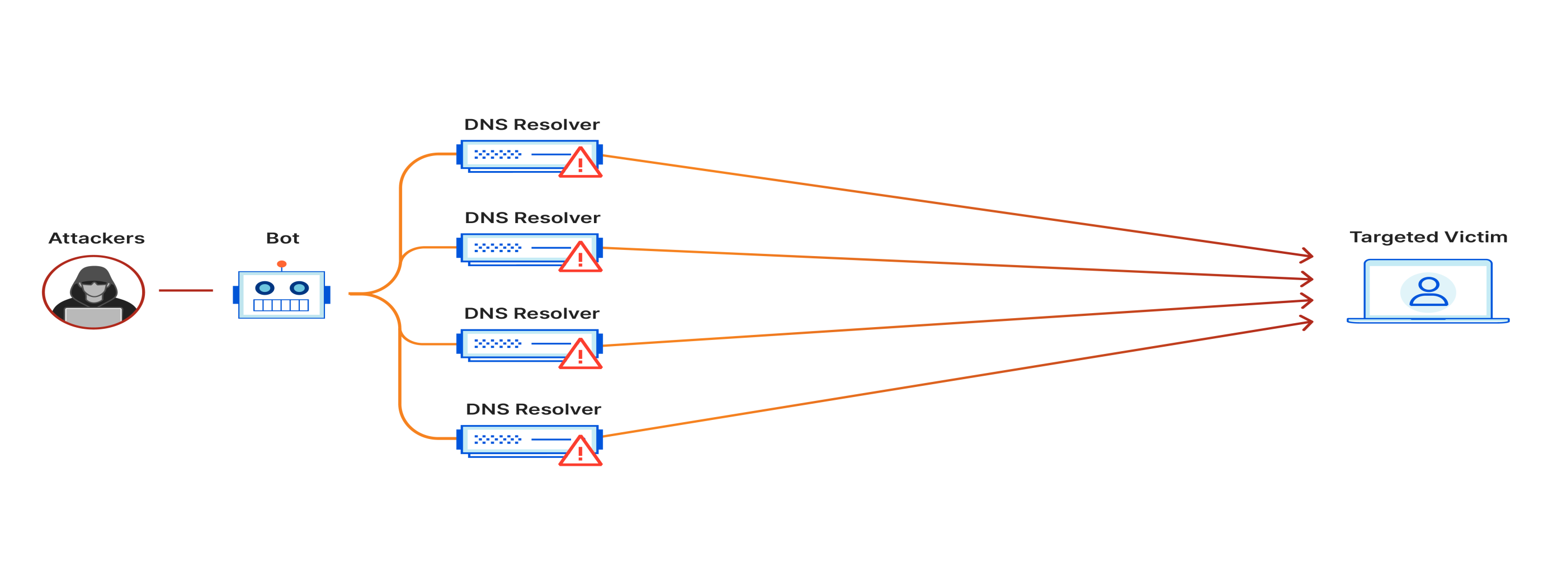
DDoS Attacks

Slide 10
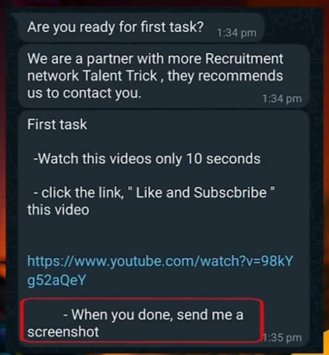

Recent Crime

Slide 11
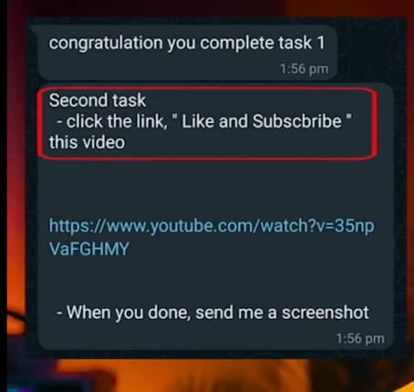
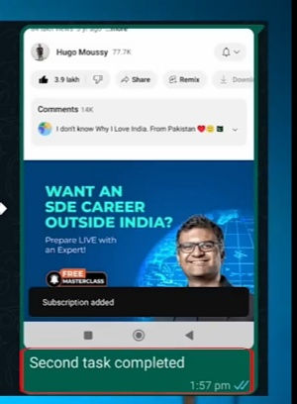
Recent Crime

Slide 12
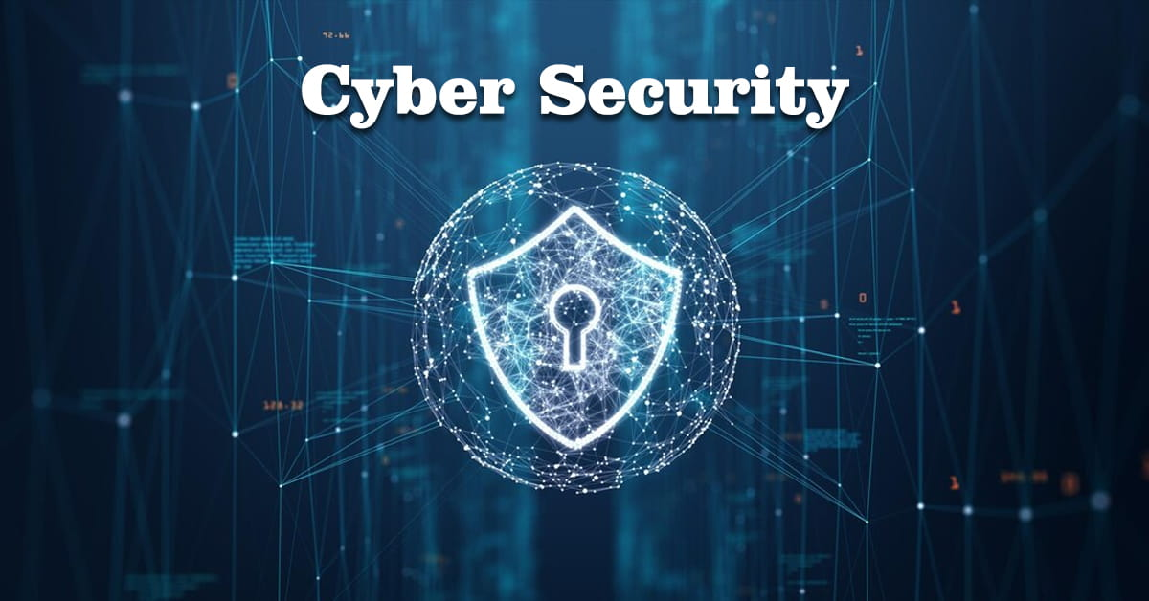

Slide 13
CYBER SECURITY
Cyber security is the practice of defending computers, servers, mobile devices, electronic systems, networks, and data from malicious attacks. It's also known as information technology security or electronic information security. The term applies in a variety of contexts, from business to mobile computing, and can be divided into a few common categories

Slide 14
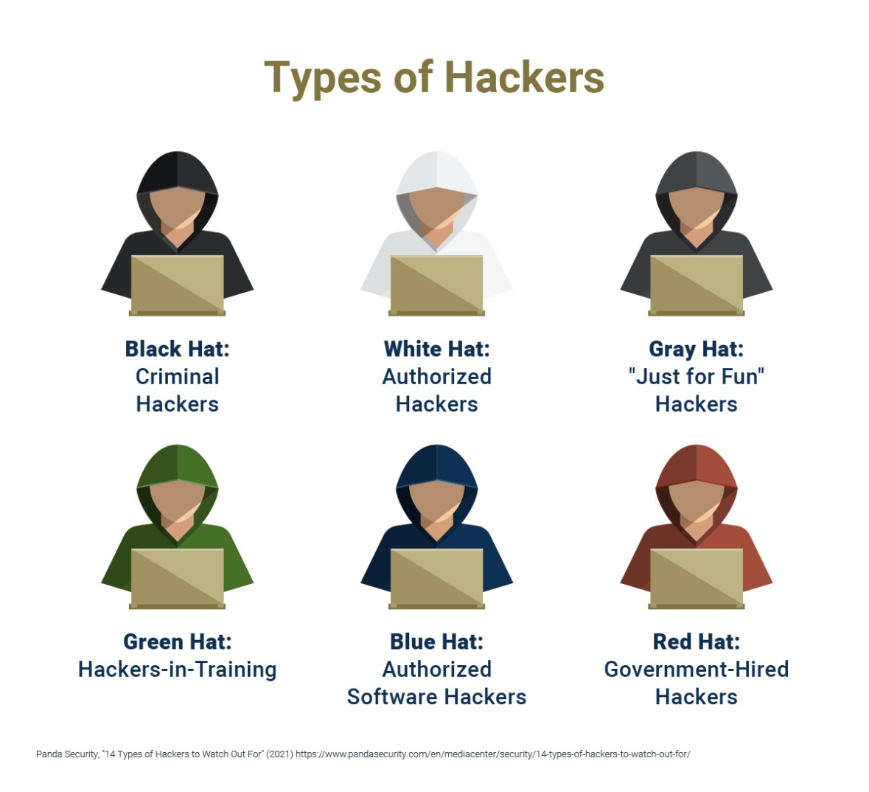
ATTACKERS GOAL
1.Unauthorized Modification
2.Unauthorized Deletion
3.Unauthorized Access

Slide 15
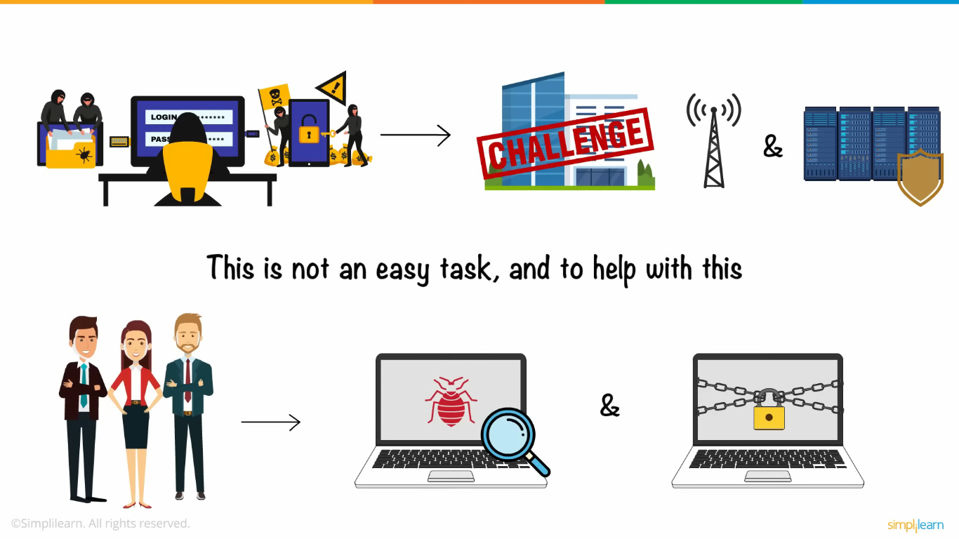

Slide 16
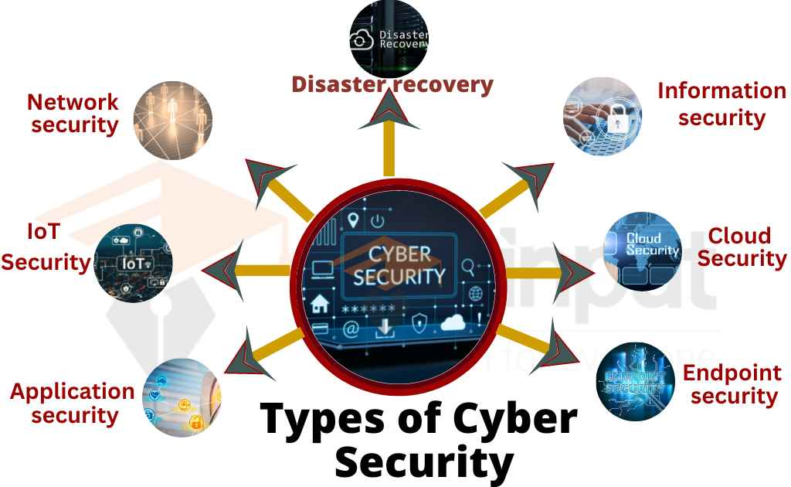

Slide 17
How To Protect Your Online Privacy
1.Use a VPN while on Public WiFi Networks
2. TOR – The Onion Router
3. Look out for phishing
4. End-to-end encrypted messaging apps
5. Use 2 Factor authentication
6. Encrypt your Emails
7. Use a Password Manager
8. Analyze your social media accounts
9. Secure browsing with HTTPS Everywhere
10. DuckDuckGo – an internet search engine

Slide 18
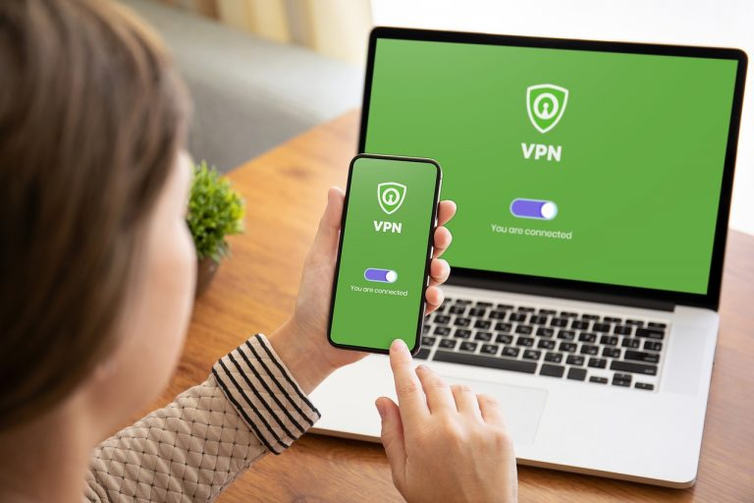
Use a VPN while on Public WiFi Networks

Slide 19

TOR – The Onion Router

Slide 20
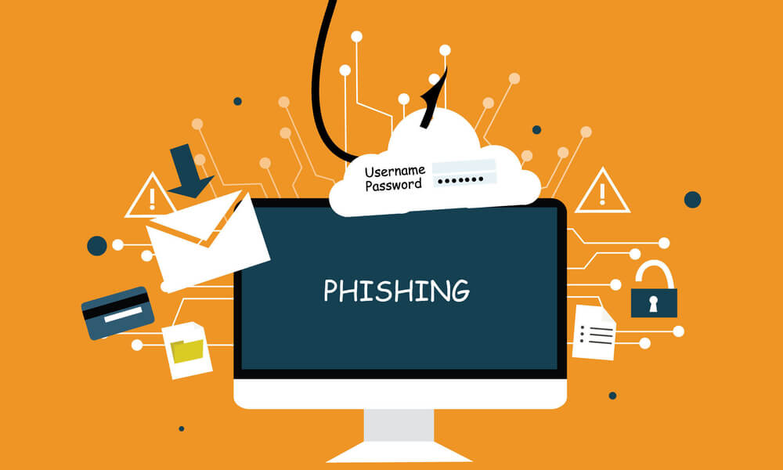
Look out for phishing

Slide 21
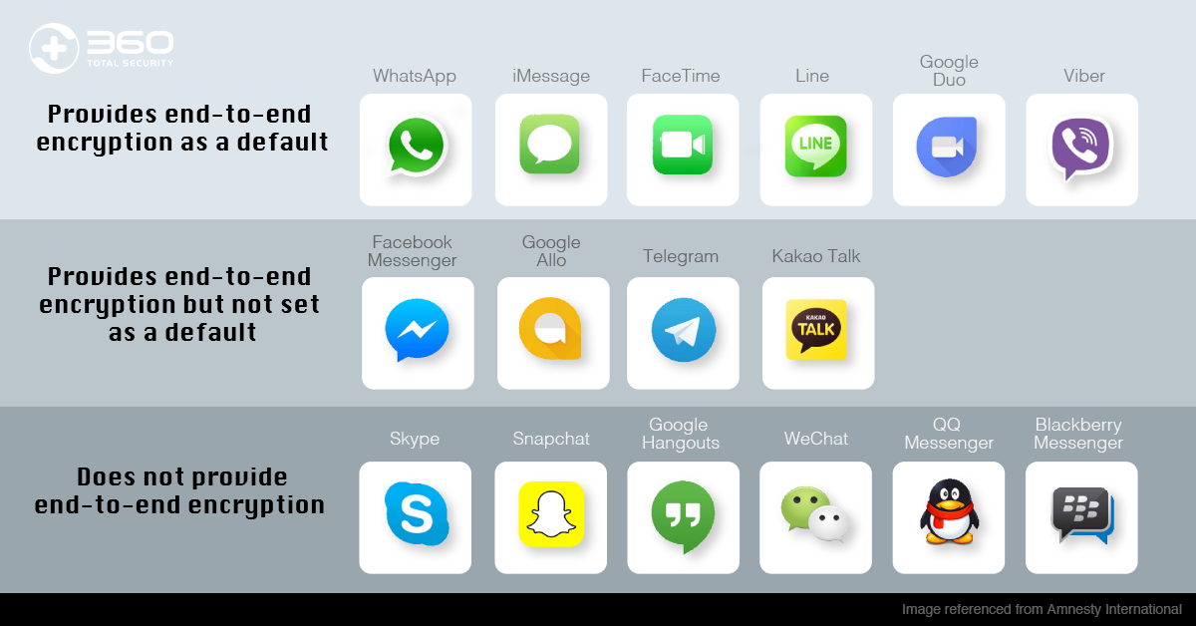
End-to-end encrypted messaging apps

Slide 22
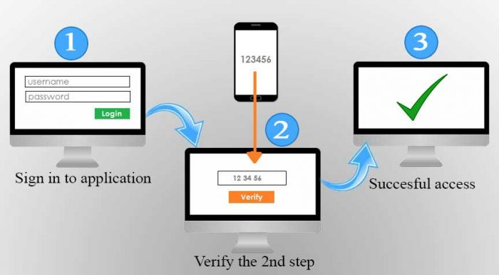
Use 2 Factor authentication

Slide 23
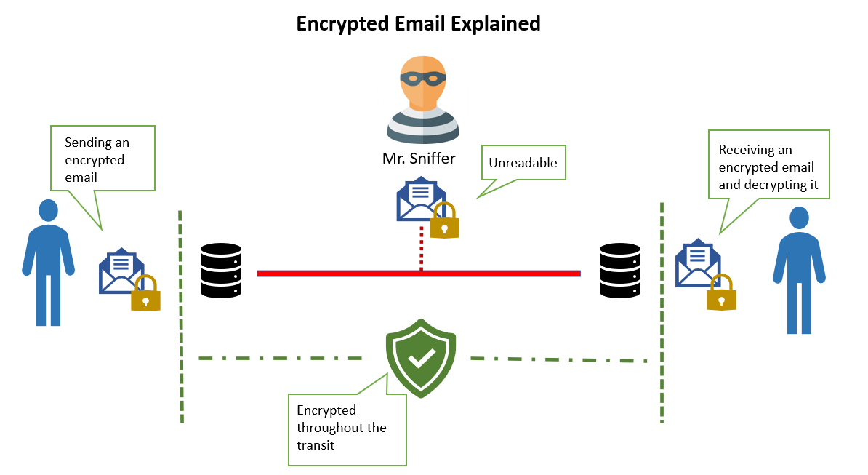
Encrypt your Emails

Slide 24
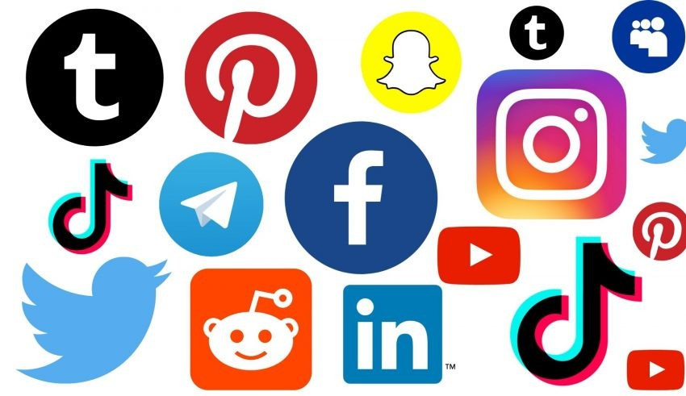
Analyze your social media accounts

Slide 25

Secure browsing with HTTPS Everywhere

Slide 26

DuckDuckGo – an internet search engine

Slide 27


